Slide 1

Sherlock Advanced Persistent Threat Detection System Rony Xavier

Slide 2
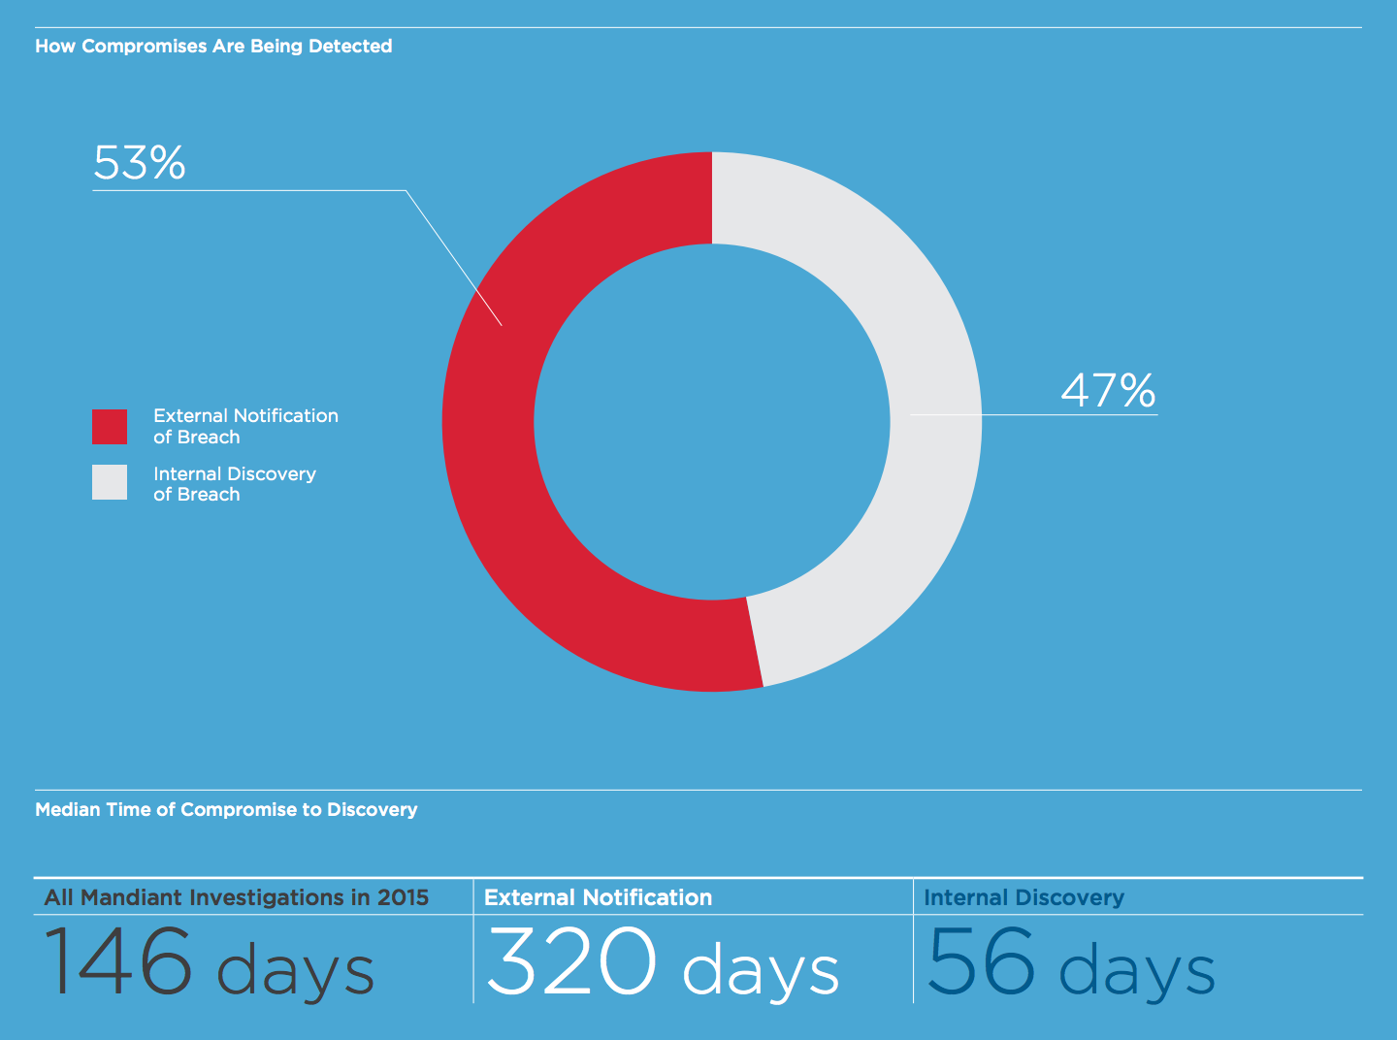
Advanced Persistent Threat (APT)
Advanced Persistent Threat (APT)
Gains access to a network
Stays there undetected for a long period of time.
Intention of an APT attack is to steal data
Not to cause damage
Not easily detected by traditional cyber security measures

Slide 3
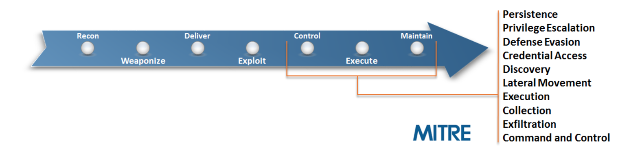
Cyber Kill Chain & MITRE ATT&CK
Cyber Kill Chain
Reveals overall the stages of a cyberattack.
Adversarial Tactics, Techniques, and Common Knowledge (ATT&CK™)
Adversary behavior model after Exploit.

Slide 4
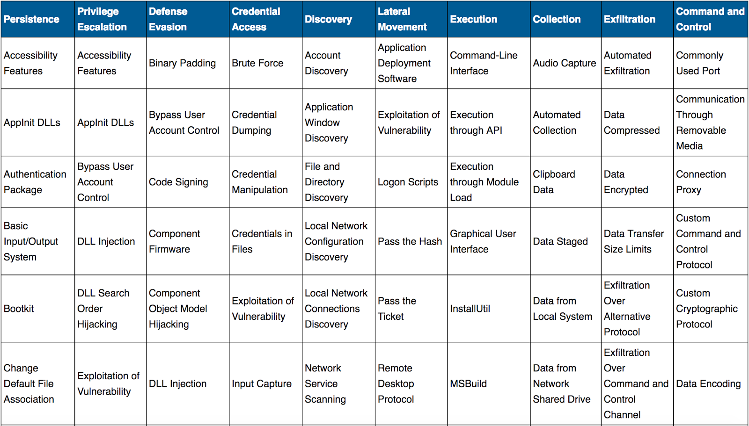
MITRE ATT&CK Matrix
Techniques
Cyber Attack techniques used by the adversary.
Tactics
Stages in the ATT&CK chain the Techniques fall into.

Slide 5
MITRE Cyber Analytics Repository
Describes analytics to detect ATT&CK Techniques.
Cyber Analytics Repository
ATT&CK
Techniques
ATT&CK
Tactics

Slide 6
Sherlock
Purpose
Detect possible indicators of attack techniques from event logs.
Categorize events into stages of attack.
Visualize if a chain of attack behaviors.
Enable the user the see patterns and make the connections.
Decrease Advanced Persistent Threat detection time.
Purpose is NOT
To replace an anti-virus tool.

Slide 7

Sherlock Design
Windows Machine
Winlogbeat
Sherlock
Windows Machine
Winlogbeat
Logstash
Elasticsearch
Kibana
Windows Machine
Winlogbeat

Slide 8
Design (Collection)
Windows Machine
Winlogbeat
Sherlock
Windows Machine
Winlogbeat
Logstash
Elasticsearch
Kibana
Windows Machine
Winlogbeat

Slide 9
Design (Storage and Analysis)
Windows Machine
Winlogbeat
Sherlock
Windows Machine
Winlogbeat
Logstash
Elasticsearch
Kibana
Windows Machine
Winlogbeat

Slide 10
Design (Visualization)
Windows Machine
Winlogbeat
APTDS
Windows Machine
Winlogbeat
Logstash
Elasticsearch
Kibana
Windows Machine
Winlogbeat

Slide 11
Collection
Process Events Logs
Network Events Logs
Sysmon
Winlogbeat
Logstash
System Event Logs
Security Event Logs
Application Event Logs
Windows Event Logs

Slide 12
Storage and Analysis
Collect time-slice of logs
Store
Elasticsearch
Elasticsearch
Sherlock
Sherlock
Perform live monitoring and analysis.
Collect time-slices of logs.
Perform analysis based on Cyber Analytics Repository using Spark.
Classify the logs to appropriate ATT&CK Tactics.
Store back in Elasticsearch.

Slide 13
Visualization

Slide 14
Visualization(Tactics and Techniques)

Slide 15
Visualization(Timeseries)

Slide 16
Visualization(Monitored Systems)

Slide 17
Visualization(Logs)

Slide 18
Likey Presence of APT

Slide 19
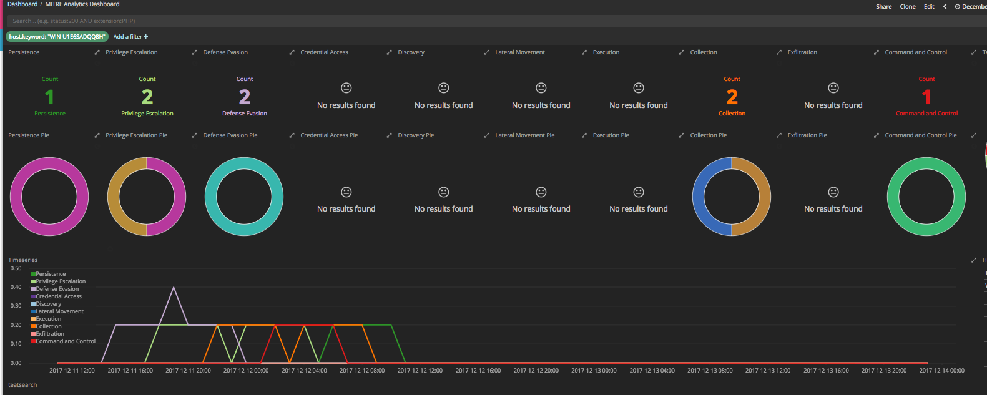
Unlikely Presence of APT

Slide 20
Conclusion
APTDS could be a valuable tool in detecting the presence of APTs.
Visualizations are significantly more effective than going through log text.
It can enable even a novice Cyber Security Analysts make expert level analysis.
Future Work
Enhance with machine-learning.
Enhance to include MITRE’s private Cyber Analytic Repository.
Request open-source support.

